Slide 1
Compiler design(UNIT-5 )

Slide 2
code generation

Slide 3
Code Generator
Input:
Intermediate code(Output of the front end of the compiler) + symbol table entries(postfix notation, three address representations e.g. quadruples, triples, graphical representations e.g., Syntax tree and dag)
Output:
Target program[Machine language(absolute(fixed location in the memory) & relocatable(object module or subprograms)] and Assembly language(more flexible as some work can be handled by the assembler)]

Slide 4
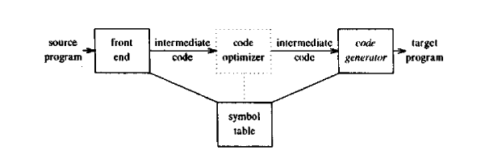
Fig1: Code generator’s position

Slide 5
ISSUES IN THE DESIGN OF A CODE GENERATOR
Memory Management:
Names mappings during run time is carried out in this stage + front end
Use the symbol table(e.g. to locate the names used in three address statements).
Compute relative addresses of a particular procedure.
Instruction Selection:
Proper selection of instruction set( uniformity, completeness, instruction speeds etc)
Low cost.
E.g.
MOV a, R0
ADD #1,R0
MOV R0, a
Can be replaced by: INC a

Slide 6
ISSUES IN THE DESIGN OF A CODE GENERATOR contd…
Register Allocation:
Determine what values in a program should reside in registers.
Efficient use of registers.
Choice of Evaluation Order:
The order in which computations are performed can affect the efficiency of the target code

Slide 7
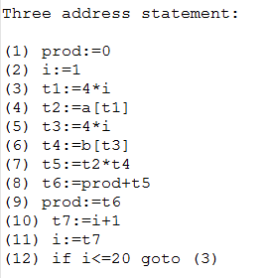
Construction of basic blocks and Flow Graph
1) The first statement is a leader.
2) Any statement that is the target of a conditional or unconditional goto is a leader.
3) Any statement that immediately follows a goto or conditional goto statement is a leader.
Example:

Slide 8
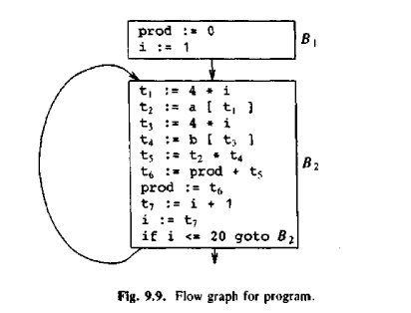
Construction of basic blocks and Flow Graph contd…
Fig 2: Flow graph

Slide 9
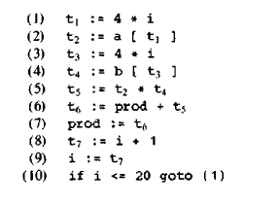
DAG representation of basic blocks
Leaves are labeled by unique identifiers, either variable names or constants.
Interior nodes are labeled by an operator symbol.
Nodes are also optionally given a sequence of identifiers for labels.
Example:
Fig : Three address code of Block B2

Slide 10
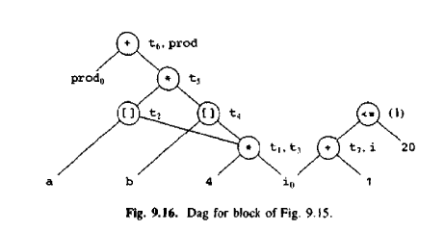
Fig : Dag for Three address code of Block B2

Slide 11
TRANSFORMATIONS ON BASIC BLOCKS
STRUCTURE-PRESERVING TRANSFORMATIONS : The primary structure-preserving transformations on basic blocks are:
common sub-expression elimination
dead-code elimination
renaming of temporary variables
interchange of two independent adjacent statements

Slide 12
Principle sources of optimization
Transformations of code can be local or global:
Function preserving Transformations:-
Elimination of common sub-expression
Copy propagation
Elimination of dead code, etc.

Slide 13
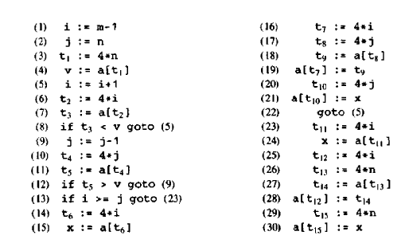
Example:
Fig:3 Three address statements

Slide 14
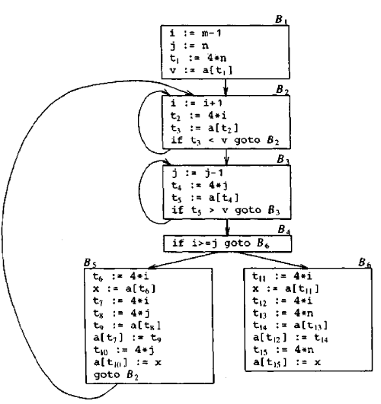
Flow graph of Fig: 3

Slide 15
Elimination of common sub-expression:
Local Elimination:
Before Elimination:
B5:
t6=4*i
x=a[t6]
t7=4*i
t8=4*j
t9=a[t8]
a[t7]=t9
t10=4*j
a[t10]=x
goto B2

Slide 16
Elimination of common sub-expression contd…
After Elimination:
B5:
t6=4*i
x=a[t6]
t8=4*j
t9=a[t8]
a[t6]=t9
a[t8]=x
goto B2

Slide 17
Elimination of common sub-expression contd…
Global Elimination:
x=t3
a[t6]=t9
a[t4]=x
goto B2

Slide 18
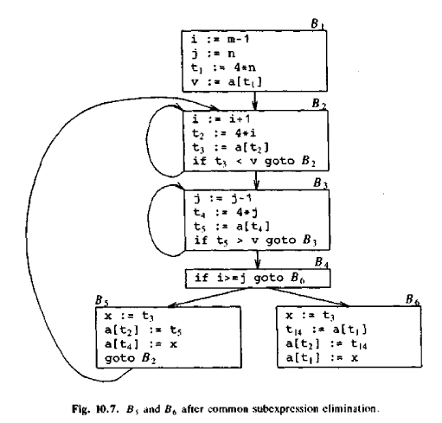
Fig.4: Flow graph of Fig: 3 after Elimination of common Sub expression

Slide 19
Copy propagation
f=g(copy)
Here, wherever f occurs it can be replaced by g.
x=t3
a[t6]=t9
a[t4]=t3
goto B2

Slide 20
Dead code Elimination
a[t6]=t9
a[t4]=t3
goto B2

Slide 21
Loop optimization
Code motion:
Moves code from inner loop to outside the loop
while(i>test+8)
if test is constant
then change i to
t=test+8
while(i>t)
Induction-variable Elimination.
i=i+1
t2=4*i
if i increases by 1, t2 increases by 4
i.e t2=t2+4
where, initial value of t2=i+1
Reduction in strength : Replace an expensive operation by a cheaper one.

Slide 22
Example:
B2:
i=i+1
t2=4*i
t3=a[t2]
if t3<v g
Change to:
B2:
t2=t2+4
t3=a[t2]
if t3<v goto B2
add t2=4*i in B1.

Slide 23
B3:
j=j-1
t4=4*j
t5=a[t4]
if t5>v goto B3
Change To:
B3:
t4=t4-4
t5=a[t4]
if t5>v goto B3
add t4=4*j in B1
Change B4 to:
if t2>t4 goto B6

Slide 24
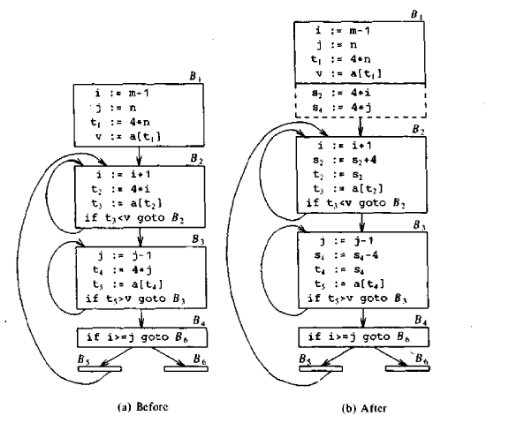
Fig 5. Strength Reduction

Slide 25
Self study:
Global data-flow analysis.

